Slide 1
Embedded in Healthcare & Industrial applications

Slide 2
Embedded Systems in Medical Applications:
the rapid adoption of artificial intelligence (AI) and Internet of Things (IoT) devices is transforming the industrial landscape. The trend is only beginning.
A revolution is underway in advancing mobile communications, smart cities, connected transport, advanced manufacturing, and connected healthcare.
The advent of 5G networks enables new types of devices and high data transfer volumes. In healthcare, this is changing the development of electronic medical device design.
How?
The convergence of IoT with embedded systems is creating new applications that will change the face of patient care.
The rise of chronic illnesses and aging populations are changing the approaches to health services.
Heart attacks, cancer, and diabetes kill 41 million people annually. That accounts for 71% of all deaths. How can medical electronics help

Slide 3
Embedded systems in healthcare are not a new concept. They are part of larger operating systems that track vital signs, amplify sounds, and run imaging scans. Magnetic resonance imaging (MRI), X-ray scanners, and pulse oximeters have long been used in medical treatment. However, the adoption of IoT is increasing the use of advanced portable devices. One way to control chronic illnesses is to reduce risk factors. Investing in managing these diseases by detecting, screening, and treating them early is critical.
Where do embedded systems come in? They can track patients as they go about their daily lives and provide insights into their symptoms. Patients are now given glucose monitors, pacemakers, and connected inhalers to manage their conditions. Wearable biosensors can detect the early onset of illness. And smartwatches that track exercise, sleep patterns, and vital signs are becoming popular among consumers. Advances in semiconductor technology have increased the complexity of embedded systems. This creates new possibilities for patient care. Devices are now small enough to be worn as jewelry or implanted under the skin. They use little power, so they require only small batteries. This makes new forms of treatment a reality.

Slide 4
1. Connected Inhalers
Smart inhalers can help track medication and provide alerts when the patient needs to take a dose. Connected apps can guide patients on how they use the inhaler and offer insights like allergen forecasts. Sensors can track the patient’s breathing and alert their doctor if there are problems. The doctor can then adjust their treatment as necessary.
2. Glucose Monitors and Pumps
Patches or implants that contain smart sensors can measure blood glucose painlessly. Patients no longer have to prick their fingers or have blood drawn to test their glucose levels. Insulin delivery systems deliver a continuous flow of insulin using an automatic pump. This makes it easier for patients to manage their disease at home and better control their health. They can avoid extreme blood sugar highs and lows, reducing the burden on the healthcare system.
3. Fitness Trackers
Smartwatches no longer only count steps. They can collect various biomedical data from heart rate to calorie intake and loss, water consumption, and sleep patterns. Some technologies use sensors that send microcurrents through the body to measure a patient’s health.
4. Smart Hospital Beds
Embedded sensor apps in smart beds can continuously track a patient’s vital signs and alert healthcare staff if there are changes. This can help them respond to emergencies immediately and achieve better outcomes. Smart beds can also adjust to the most comfortable position for the patient.

Slide 5
5. Preventive Care
Doctors are expanding their focus beyond emergency care to address the needs of aging populations. Medical devices that track a patient’s vital signs can identify potential illnesses as they develop. Doctors can intervene early, helping to prevent chronic conditions. This reduces hospital admissions and leads to better use of resources. In embedded systems, the hardware and software need to work together. Medical devices need specific software to process and analyze the data they collect. The software must track and control various devices, wearables, and other biomedical equipment. The hardware must be robust and reliable. The devices must deliver data clearly for doctors and patients to interpret. They must also be checked regularly to ensure the sensors work as they should.
The Future of Medical and IoT Devices
The next generation of electronic medical device design is emerging that will take healthcare to the next level. For example, wearable devices can inject patients with medication based on their medical condition. The electronic and embedded software for medical devices is becoming ever more complex. It is also essential that IoT devices keep the personal data they collect secure to protect patient privacy. Development teams must have the right experience to deliver high-quality solutions with minimal risk while meeting the highest medical certification standards

Slide 6
Automatic Pill Dispenser
https://drttit.gvet.edu.in/Naac-Docs/Criteria1/1-3-3/Hemanth-Kumar.pdf
https://slideplayer.com/slide/12441676/

Slide 7
Industrial Automation
•Typical application domains of industrial automation are in control of industrial processes, power supply, industrial robots. Industrial automation domain comprises a large area of control, monitoring and optimization systems
• Most control systems are manufactured in rather large volumes, and must to a large extent be configurable to suit a variety of customer contexts.

Slide 8
• They can be classified according to different levels of control:
i) Process level (for example, a valve in a water pipeline, a boiler, etc.)
(ii) Field level that concerns sensors, actuators, drivers, etc
(iii) Group control level that concerns controller devices and applications which control a group of related process level devices in a closed-loop fashion
(iv) Process control level i.s. operator stations and processing systems with their applications for plant-wide remote supervision and control
(v)Production or manufacturing management level that includes systems and applications for production planning

Slide 9
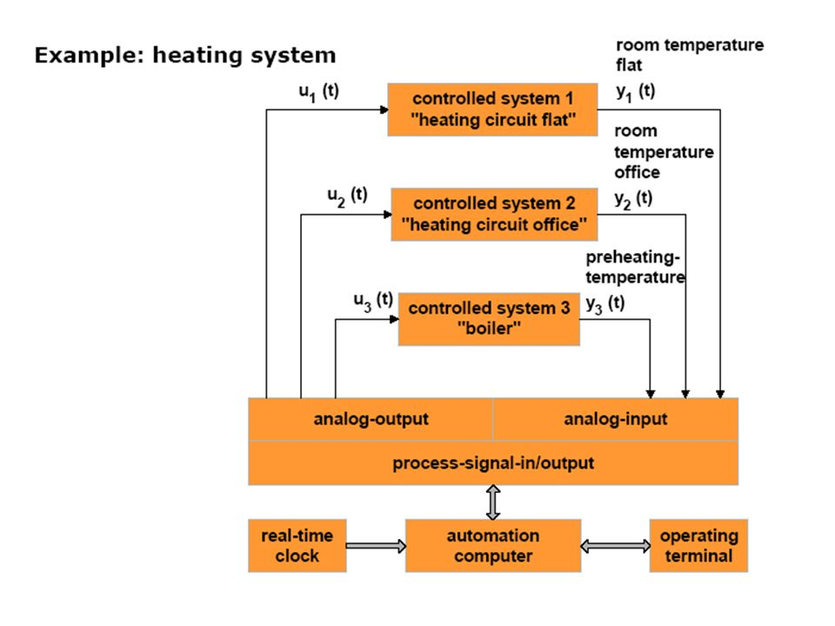

Slide 10
https://www.slideshare.net/slideshow/ch-5-industrial-control-systemsppt/253413672
https://slideplayer.com/slide/10976069/

